Slide 1
Project Title: Currency Converter
Objective
The goal of this project is to create a simple currency converter program in C that allows users to convert one currency to another based on current exchange rates. This project will reinforce concepts of arithmetic operations and user input handling in C.

Slide 2
Key Components of the Project
Data Structure for Currency Rates: We will create a structure to store currency codes and their corresponding exchange rates.
User Interaction: The program will prompt the user for inputs and handle their responses.
Conversion Logic: We will implement the mathematical logic to convert currencies based on rates.
Output Display: Finally, the program will present the results to the user in a clear format.

Slide 3
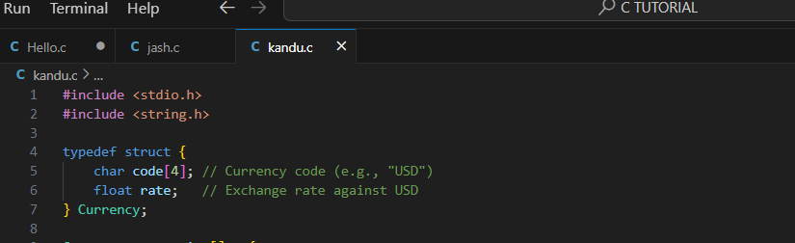
Step-by-Step Implementation
1. Define the Currency Structure
We will define a Currency structure to hold the currency code and its exchange rate relative to a base currency (e.g., USD).
c

Slide 4
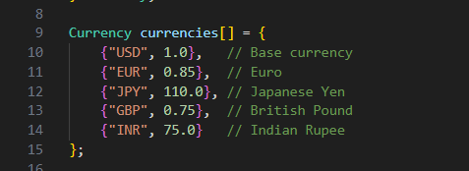
2. Initialize Currency Data
We will create an array of Currency to hold some common currencies and their exchange rates.

Slide 5
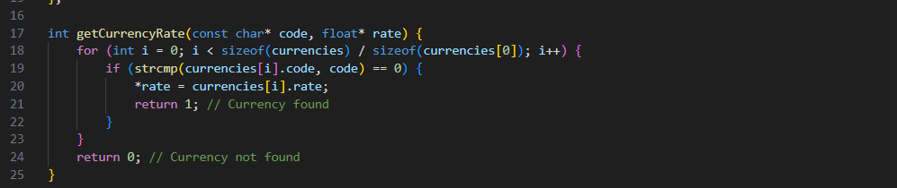
3. Function to Get Currency Rate
We need a function to retrieve the exchange rate for a given currency code. If the currency code is invalid, the function will return an error.

Slide 6

4. Currency Conversion Logic
To convert an amount, we need to convert it to USD first (if it’s not already in USD) and then to the target currency. Here’s the conversion function:

Slide 7
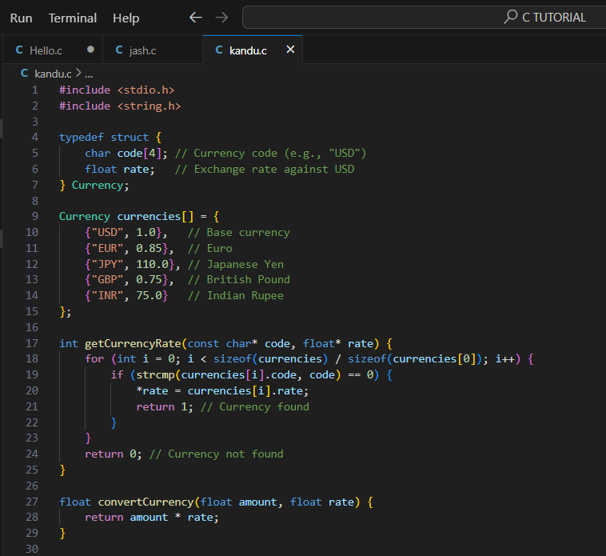
. Main Program Logic
Now, let’s combine all of these components in the main function, where we will handle user input and output.

Slide 8
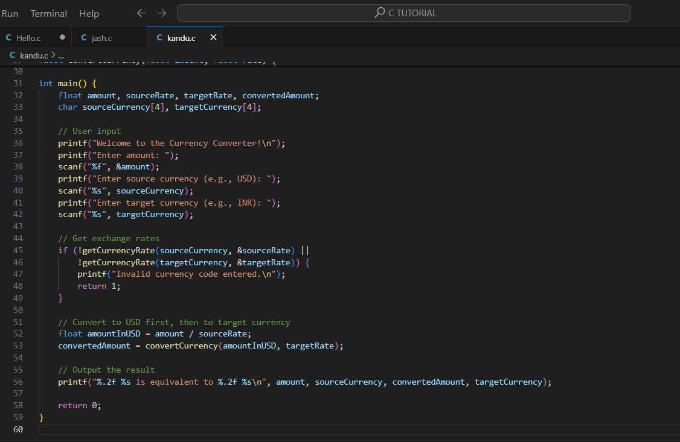

Slide 9
Code Explanation
Data Structures: We define a structure to store currency codes and rates, and an array to hold the predefined currencies.
Input Handling: The program asks the user to enter an amount and the currency codes for conversion.
Error Checking: We validate the currency codes and provide feedback if invalid.
Conversion Logic: The program converts the amount to USD first, then to the target currency.
Output: The result is formatted and printed, showing the converted amount clearly.

Slide 10
VISUAL REPRESENTATION OF THE FLOW
start
Initialize Currencies
Display Welcome Msg

Slide 11
Get User Input (Amount, Source, Target Currency
Get Source Currency Rate
Get target Currency Rate
Check for Invalid
Currency Code?
yes
no

Slide 12
Display Error Msg (end program)
Convert Amount to USD (amount / sourceRate)
Convert to Target Currency (USD * targetRate)
Display result(converted amount)
End

Slide 13
Description of the Flowchart Steps
Start Program: The program begins execution.
Initialize Currencies: The array of currencies with their respective exchange rates is set up.
Display Welcome Message: A friendly message is displayed to the user.
Get User Input: The program prompts the user for:
Amount to convert
Source currency (e.g., USD)
Target currency (e.g., INR)

Slide 14
Get Source Currency Rate: The program retrieves the exchange rate for the source currency and checks if it’s valid.
Get Target Currency Rate: Similarly, it retrieves the exchange rate for the target currency.
Check for Invalid Code: The program checks if either currency code is invalid.
If invalid, it displays an error message and ends the program.
If valid, it continues to the next step.
Convert Amount to USD: The amount is converted to USD using the source currency rate.
Convert to Target Currency: The program calculates the equivalent amount in the target currency.
Display Result: The converted amount is displayed to the user.
End Program: The program concludes its execution.

Slide 15
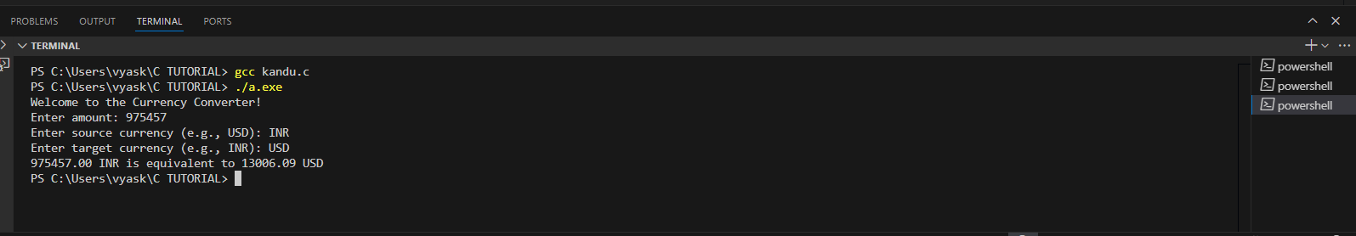
Testing the Program
Valid Inputs:Test with various valid amounts and currency code

Slide 16
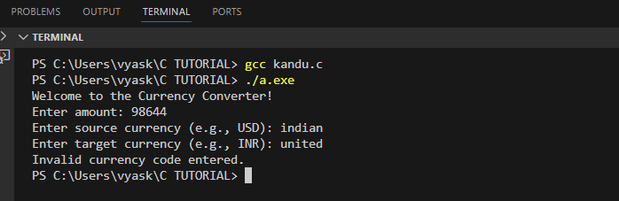
Invalid Inputs: Enter invalid currency codes to ensure the error handling works.

Slide 17
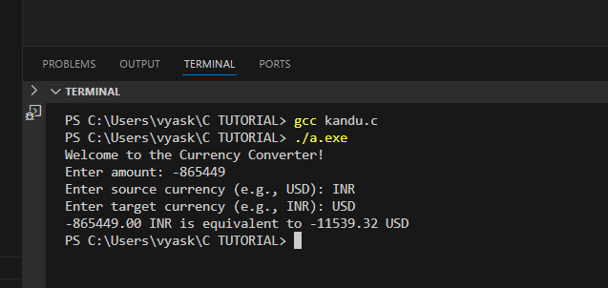
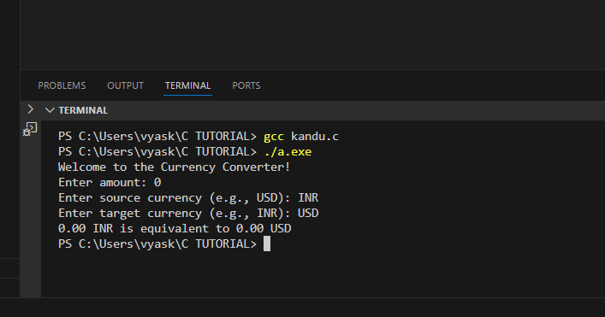
Edge Cases: Test with zero or negative amounts and observe the output.

Slide 18
Conclusion
The Currency Converter project exemplifies the application of core programming concepts in C, including data structures, user input handling, and arithmetic operations. It effectively demonstrates:
Data Management: Utilizing structures to organize currency data.
User Interaction: Gathering and validating input to enhance user experience.
Mathematical Computation: Applying arithmetic for real-world currency conversion.
Flexibility: Allowing easy additions of new currencies and rates.
Practical Application: Bridging theory and practice to solve everyday problems.
Overall, this project not only reinforces coding skills but also illustrates the real-world utility of programming, laying a strong foundation for future challenges.

Slide 19
THANK YOU!
BEST REGARDS
VYAS KANDARP(24AIML075)
HIMAY THUMMAR(24AIML069)
SHARANAM KATWALA(24AIML063)

